Slide 1

Database Indexes Made Simple

Slide 2
What Are We Going To COVER
Why Indexing is a Developer’s Task
Anatomy of an Index
B-Trees and Doubly Linked Lists
Slow Indexes
Execution Plans
The WHERE Clause and Common Pitfalls

Slide 3
Indexes are developer’s task
The information for proper indexing is in the application code
How it queries data
This knowledge is not accessible to database administrators
Or external consultants
The development team has that information right away
So it is your task to understand indexing!
Clustered vs Non-Clustered index:
Clustered – the primary key usually, one per table – saves the physical order of the data
Non-Clustered – additional indexes, multiple per table – defined by the developer

Slide 4
Anatomy of an index
An index is a distinct structure in the database
It is stored separately from the normal table
It requires separate disk space
Creating an index creates a separate data structure
Which refers to the table data and does not change it
Like a book index
It orders all the data in the books
And refers to the page for more information
Searching an index is like searching in a printed phone directory
Entries are arranged and finding data is fast and easy
The difference is that in databases data changes frequently

Slide 5
The doubly linked list
Storing the data in a normal list will make the insert statement quite slow
So the first data structure is doubly linked list
Each node refers to the previous and next one
Inserting a new entry just changes a few pointers and do not move the entire set
Each database node contains multiple entries
Data is sorted in the nodes themselves and between them

Slide 6
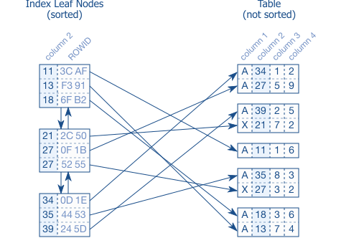
The doubly linked list

Slide 7
The B-tree
The linked list leaf nodes are stored in random order in the disk
So we need a separate data structure to find them fast enough
A B-Tree to the rescue – balanced search tree
The B-Tree nodes refer to the biggest values in each linked list node
Making search operations to be very efficient
Once created, each B-Tree is maintained by the database automatically
B-Trees works very fast even with huge data sets
B-Tree simulator:
https://www.cs.usfca.edu/~galles/visualization/BPlusTree.html

Slide 8
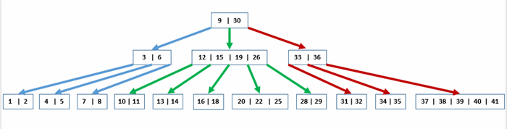
The B-tree

Slide 9
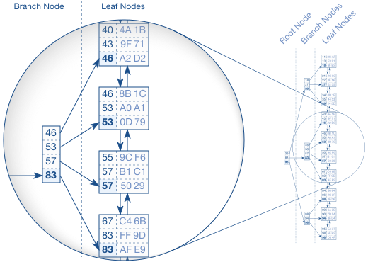
The B-tree

Slide 10
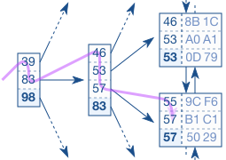
Searching The B-tree in a database

Slide 11
Slow indexes
The B-Tree itself is super fast because of the logarithmic complexity
The first ingredient for a slow index lookup is the leaf node chain
Entries can be repeated so the database needs to follow the leaf nodes
The second ingredient is accessing the actual table
Each lookup may have hundreds of results
Index lookup has the following steps
Tree traversal – fast, exponential
Following the leaf node chain – may be slow for multiple entries
Fetching table data – may be slow for multiple entries
Myth: rebuilding indexes improves their performance!

Slide 12
EXECUTION PLAN
In SQL Server you can include the execution plan of your query
Just turn on “Include Actual Execution Plan” or hit Ctrl + M
Common operations in the plan considering indexes:
Index Seek, Clustered Index Seek – performs a B-Tree traversal efficiently
Index Scan, Clustered Index Scan – reads the entire index – all rows in the index order (slow)
Key Lookup (Clustered) – retrieves a single row from a clustered index
RID Lookup (Heap) – retrieves a single row from a table
Table Scan – reads the entire table – all rows and columns
In terms of performance (best to worst):
Index Seek, Clustered Index Seek, Index Scan, Clustered Index Scan, Table Scan

Slide 13
The WHERE Clause with functions
The “where” clause can be poorly written no matter your indexes
Imaging you have a column last_name and an index for it
But you execute a case-insensitive search:
From a database perspective, the upper-cased last name is different
So it doesn’t use the index for the column at all!
All user-defined functions also do not include the index
You need to create a special index for each function you use with a precomputed column!
But be careful – do not over-index without an actual need for it!
SELECT first_name, last_name, phone_number
FROM employees
WHERE UPPER(last_name) = UPPER('some name')

Slide 14
The WHERE Clause with ranges
When you have range search with multiple columns, you need to be careful
You can create an index on both columns, but on which order?
Correct answer is:
Index for equality first
Then for ranges!
SELECT Id, Age
FROM Cats
WHERE Name = 'Lotus' AND Age BETWEEN 1 AND 4

Slide 15
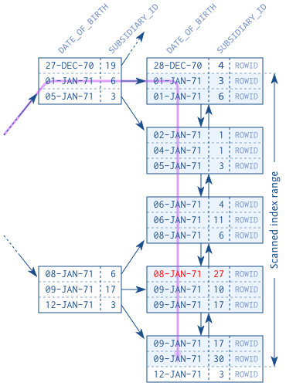
Search by range first

Slide 16
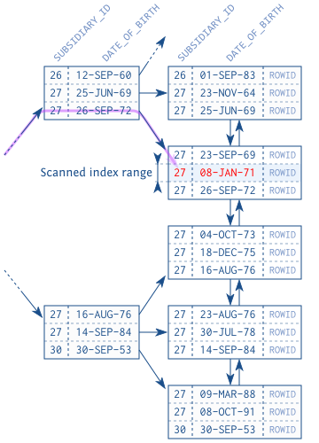
Search by index first

Slide 17
The WHERE Clause with like operator
The LIKE operator often causes unexpected performance problems
Avoid LIKE expressions with leading wildcards (e.g., '%TERM')
Performs a scan
You can search with ending wildcards (e.g., 'TERM%')
Performs a seek
The more selective the prefix, the smaller the scanned index will become
SELECT Id, Name
FROM Cats
WHERE Name LIKE 'Lotu%'

Slide 18
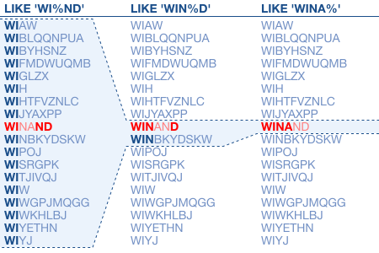
Search with like

Slide 19
Multiple columns
Is it better to have two indexes for two columns or a single combined index?
The answer is very simple in most cases – one combined index!
One index scan is faster than two!
Additionally, if you have two indexes, the database will need more CPU to combine the intermediate results

Slide 20
Filtered indexes
When you have constant values in your data, it may be a good idea to use a filtered index to save disk space and optimize the performance
If you have lots of queries that looks like this:
You can create a filtered index with a WHERE clause
SELECT message
FROM messages
WHERE processed = 'N' AND receiver = ?
CREATE INDEX messages_todo
ON messages (receiver)
WHERE processed = 'N'

Slide 21
Problematic where conditions
Dates
Typically dates are used with a function – for example to extract only the month from them
Use a function-based index as a solution
Numeric strings
Saving numbers as strings will result in a poor index performance
Use numeric types as a solution
Math
Using math expressions in your queries will not allow you to use the index potential
Use a function-based index as a solution

Slide 22
ANY QUESTIONS?

